Slide 1
Zepto SQL Data Analysis Project
Koushik bera WEBSKITTERS ACADEMY DATA ANALYTICS BATCH Batch ID: WA-303-RAKA-IT-DAT-JUL-2025-1

Slide 2
INTRODUCTION
his project simulates how real-world data analysts in the e-commerce and retail industry use SQL to analyze inventory data.
Using a real dataset from Zepto, we explore product categories, pricing, availability, and revenue to extract meaningful business insights.
GOAL
To demonstrate SQL-based data exploration, cleaning, and business analysis.

Slide 3
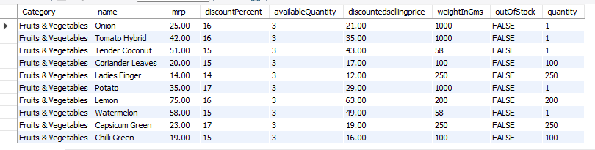
Dataset Description
Dataset Overview
The dataset was sourced from Kaggle and scraped from Zepto’s official product listings. It represents a real-world e-commerce inventory system.
Key Characteristics:
Duplicate product names exist due to different weights, packages, discounts, or categories
Reflects realistic catalog inconsistencies in online retail
Columns Include: name, category, mrp, discountPercent, discountedSellingPrice, availableQuantity, weightInGms, outOfStock, quantity

Slide 4
Problem Statement
E-commerce platforms store massive volumes of raw product data, but challenges arise due to:
Pricing inconsistencies (paise vs rupees)
Null and invalid values
Duplicate product listings
Difficulty in evaluating inventory, discounts, and revenue
Need: To clean, structure, and analyze this data using SQL to generate business insights.

Slide 5
Objective of the Study
Build a real-world e-commerce inventory database in SQL.
Perform Exploratory Data Analysis (EDA) on products, categories, and stock.
Clean the data by handling nulls, removing invalid entries, and converting prices.
Write business-driven SQL queries to analyze:
Discounts
Pricing
Inventory levels
Revenue
Stock availability

Slide 6

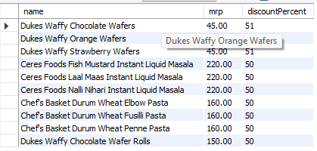
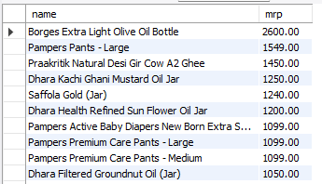

Q1. Find the top 10 best-value products based on the discount percentage.
Identifies the top 10 products offering the highest discounts, helping customers find best-value deals.
Q2.What are the Products with High MRP but Out of Stock
Finds expensive products that are unavailable, helping inventory teams restock high-value items.

Slide 7
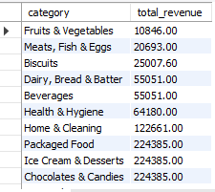
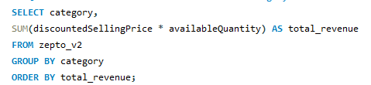
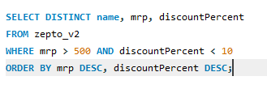
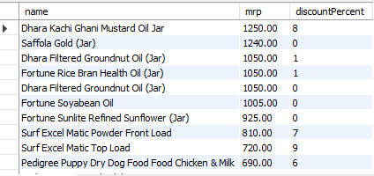
Q3. Find the top 10 best-value products based on the discount percentage.
Estimates potential revenue per category, enabling management to focus on high-performing product segments.
Q4. Find all products where MRP is greater than ₹500 and discount is less than 10%.
WHERE mrp > 500 → Filters only high-priced products.
AND discountPercent < 10 → Keeps only products with minimal discounts.
ORDER BY mrp DESC → Displays the most expensive products first.
ORDER BY discountPercent DESC → Among similar MRPs, higher discounts appear first.

Slide 8
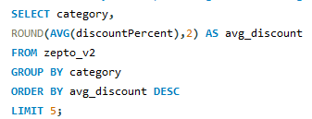
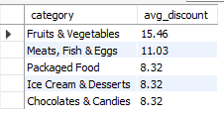
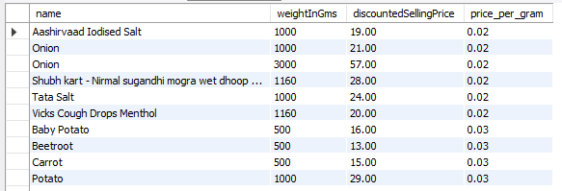
Q5. Identify the top 5 categories offering the highest average discount percentage.
AVG(discountPercent) → Calculates the average discount within each category.
ROUND(..., 2) → Rounds the average discount to 2 decimal places for better readability.
GROUP BY category → Groups all products by their category.
ORDER BY avg_discount DESC → Sorts categories from highest to lowest average discount.
LIMIT 5 → Returns only the top 5 categories.
Q6. Find the price per gram for products above 100g and sort by best value.
WHERE weightInGms >= 100 → Filters products with sufficient weight for fair comparison.
discountedSellingPrice / weightInGms → Calculates the cost per gram.
ROUND(...,2) → Rounds the result to 2 decimal places for readability.
ORDER BY price_per_gram → Sorts results from lowest to highest price per gram, meaning the cheapest per gram appears first.
DISTINCT → Avoids duplicate product names..

Slide 9
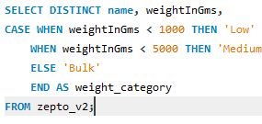
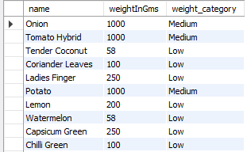
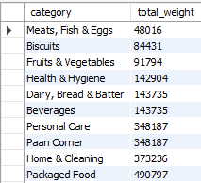
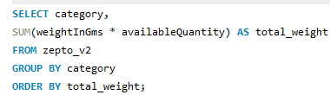
Q7.Group the products into categories like Low, Medium, Bulk.
CASE WHEN → Applies conditional logic to classify products based on weight.
Products:
Less than 1000g → Low
Between 1000g and 4999g → Medium
5000g and above → Bulk
AS weight_category → Creates a new readable column with category labels.
DISTINCT → Ensures duplicate product names are removed.
Q8.What is the Total Inventory Weight Per Category .
category → groups the products by category.
SUM(weightInGms * availableQuantity) → calculates the total inventory weight for each category (weight per unit × number of units available).
GROUP BY category → ensures the SUM is calculated per category.
ORDER BY total_weight → sorts categories by their total weight in ascending order.

Slide 10
Key Insights
1.Total Inventory weight by category
Helps indentifly which categories hold the most stock by weight.
2.Top Performing Categories (by available quantity & value)
Categories with highest available quantity indicate popular or overstocked products.
3.Potential Business Actions
Focus on high-weight/high-value categories for supply chain optimization.
Review slow-moving categories for promotions or discounts.
Fix missing/incorrect data to improve reporting accuracy.

Slide 11
Conclusion
1. Inventory Insights
Total inventory weight varies significantly across categories.
Some categories dominate stock holding → focus on optimizing storage & supply.
2. Sales & Pricing Trends
High discounts in certain categories may affect profit margins.
Top-selling categories need continuous stock monitoring.
3. Data Quality & Accuracy
Presence of nulls in key fields (name, category, mrp, availableQuantity) → potential gaps in reporting & decision-making.
4. Business Recommendations
Prioritize high-weight/high-value categories for efficient inventory management.
Implement promotions for slow-moving stock.
Clean and validate data to improve future analysis accuracy.
.
Overall: Zepto’s inventory analysis provides actionable insights for stock optimization, sales planning, and better decision-making

